Slide 1

MENTORING AND GUIDING STARTUPS: FROM IDEATION TO GROWTH

Slide 2
IDEATION STAGE
The ideation stage is the foundation of a startup's journey. It involves conceptualizing, refining, and validating an idea before moving to execution. At this stage, entrepreneurs need guidance to assess feasibility, identify target markets, and align their vision with market needs.
Key Areas
Idea Validation
Business Model Development
Market Research and Customer Discovery
Team Building
Product Development Strategy
Legal and Regulatory Considerations
Financial Planning
Pitching

Slide 3
MILESTONES FOR BECOMING SUCCESSFUL FROM IDEATION STAGE
Well-defined problem statement and solution.
Clear understanding of target customers (Demand Mapping)
Basic business model outline.
MVP concept ready for testing.
Initial customer validation.
Assess the TRL
Defined roadmap for execution.

Slide 4
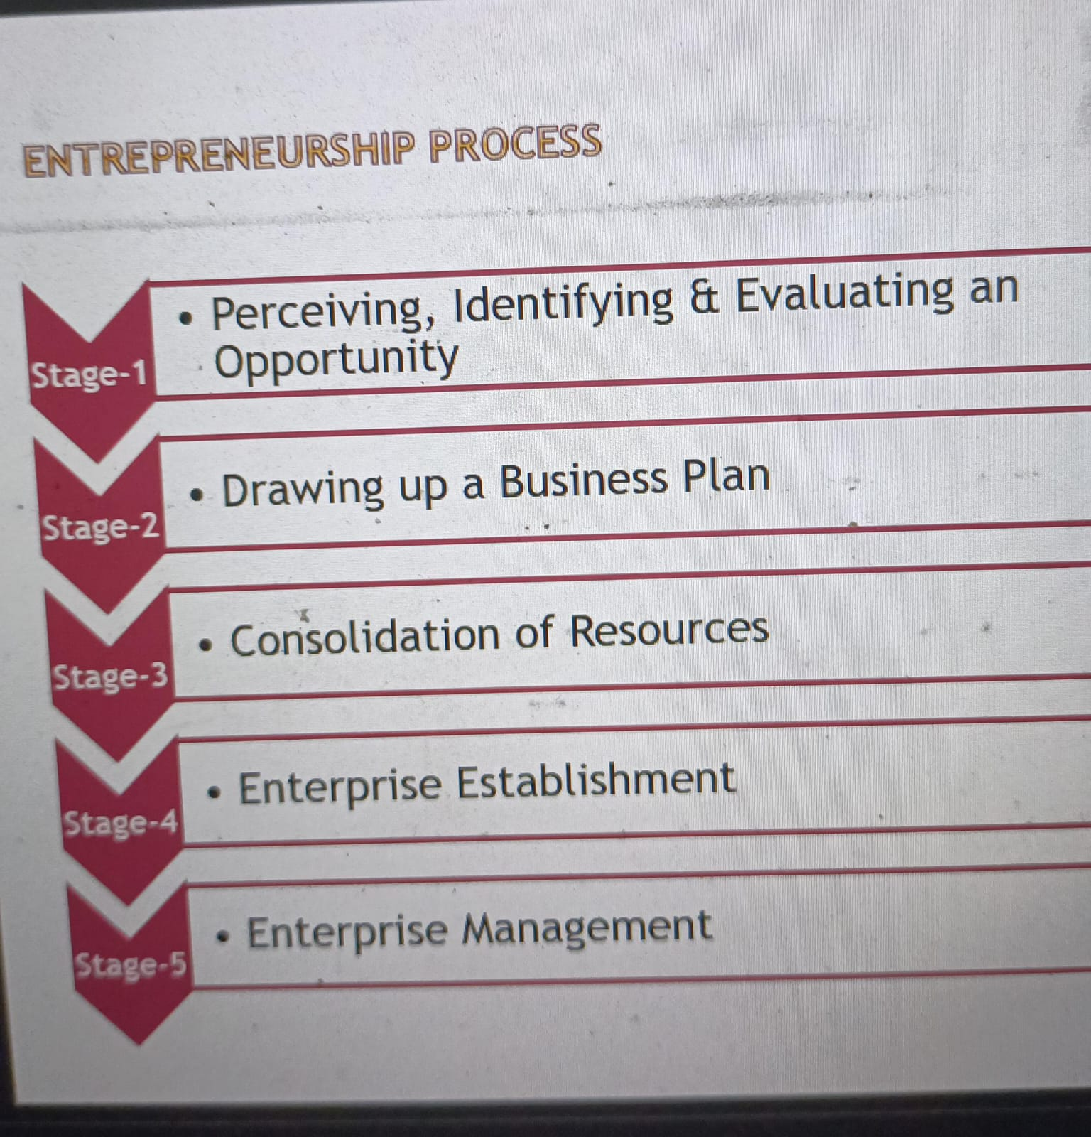

Slide 5
IDENTIFYING NEW IDEAS
Personal experience, hobbies and pastimes, personal passions
Following interesting trends and ideas
Using brainstorming to generate ideas
Solving People’s Problem
Doing Market Research

Slide 6
IDENTIFY AND EVALUATE THE OPPORTUNITY
Opportunity identification: the process by which an individual comes up with an opportunity for a new venture
The opportunity can be identified by using input from consumers, business associates, channel members, or “technical people”
Entrepreneur must understand the cause of the opportunity – is it technological change, market shift, government regulation, or competition?

Slide 7
OPPORTUNITY ASSESSMENT
What market need does it fill?
What personal observations have you experienced or recorded with regard to that market need?
What social conditions underlie the market need?
What market research data can be marshaled to describe this market need?
What patents might be available to fulfill this need?
What competition exists in this market?
What does the international market/competition look like?
Where is the money to be made in this activity?

Slide 8
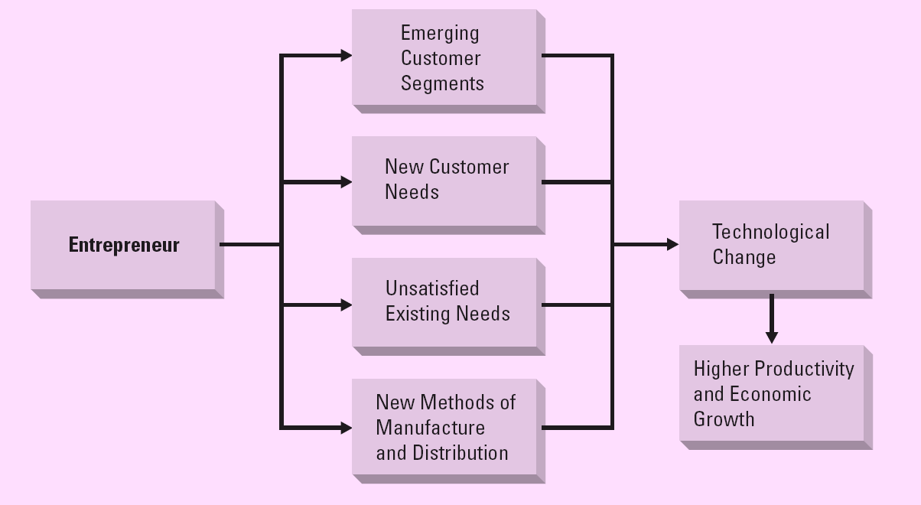
ENTREPRENEURSHIP AND TECHNOLOGICAL CHANGE

Slide 9
EVALUATING NEW IDEAS
Original?
Feasible?
Marketable?
Profitable?

Slide 10
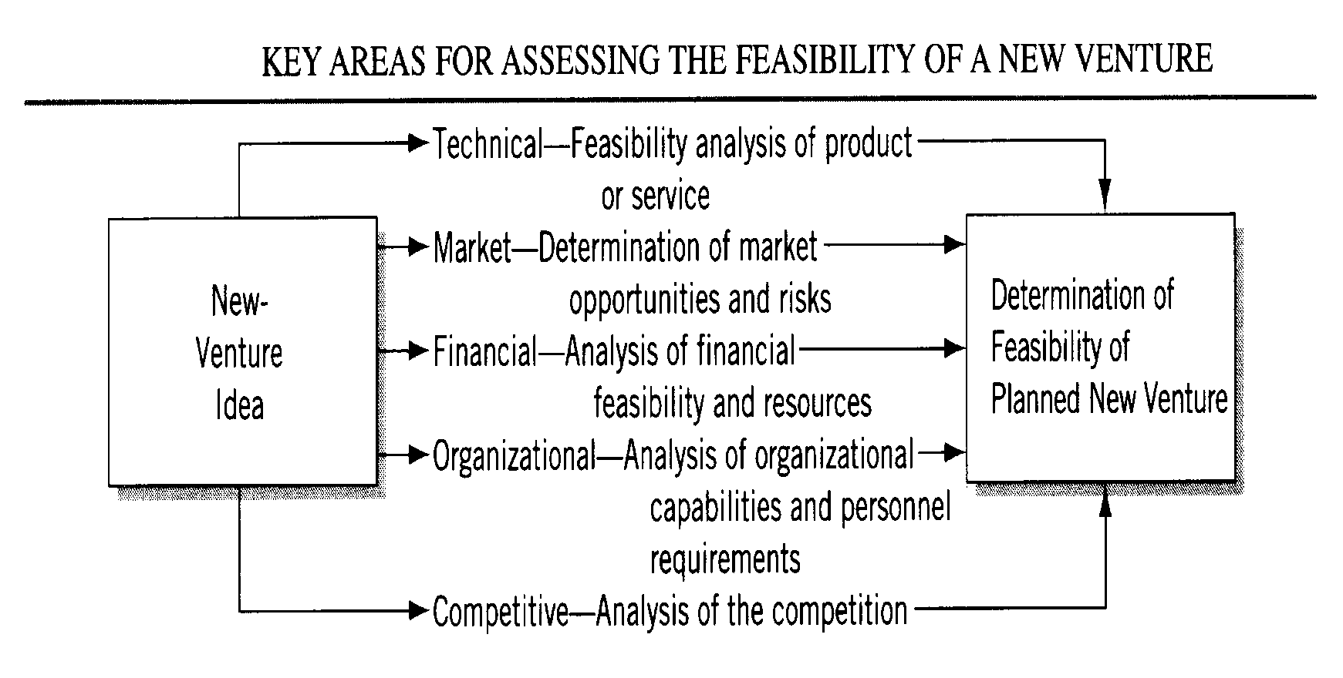
ASSESSING FEASIBILITY OF A NEW VENTURE

Slide 11
EVALUATE TECHNICAL FEASIBILITY
Ease of processing and manufacturing
Functional design and attractiveness
Flexibility, durability, reliability
Product safety
Ease and low cost of maintenance
User friendliness

Slide 12
EVALUATE MARKETABILITY
Who are my target customers?
How big are these markets?
To which extent the potential market can be exploited?
Where do my target customers normally gather?
What will be good channels to reach them?
How should I validate my assumptions with them?

Slide 13
EVALUATE FINANCIAL FEASIBILITY
For the purpose of establishing a business or attracting investors, a prospective entrepreneur should include at least three key things in the comprehensive financial feasibility study:
Start-Up Capital Requirements
Start-Up Capital Sources
Potential Returns for Investors.

Slide 14
ANALYSIS OF ORGANIZATIONAL CAPABILITIES/ PRODUCT / SOLUTION VALIDATION
Do I understand my target customers enough to come up with potential solutions to solve their problems?
What are some of the potential solutions that might be able to solve their problems?
Which is the best solution to solve this pain/problem?
How to build Minimum Viable Products?
Are the initial production costs realistic?
Are the initial marketing costs realistic?
Does the product have potential for high margins?
Is the time required to get to the market and to reach the break-even point realistic?

Slide 15
ANALYSIS OF COMPETITION
Product description
Market positioning (relative strength and weaknesses, as seen by customers)
Market practices: channels, pricing, promotion, service
Estimated market share (if relevant)
Reactions to competition
Implications for opportunity

Slide 16
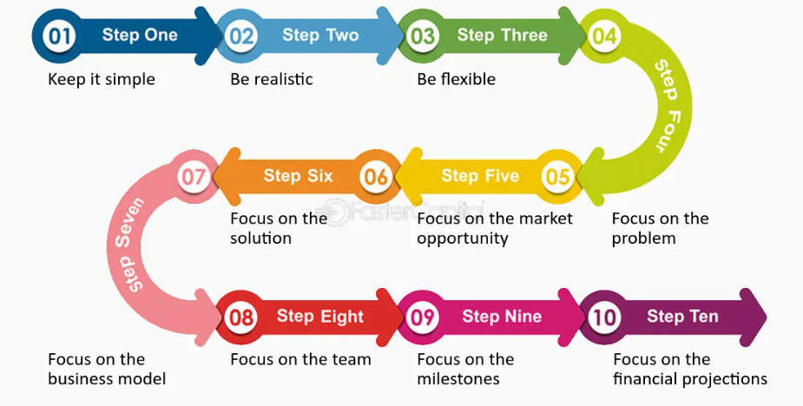
BUSINESS PLAN

Slide 17
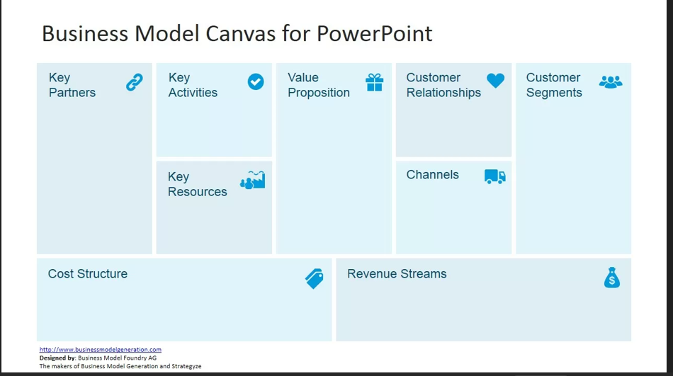
BUSINESS MODEL CANVAS

Slide 18
BUSINESS MODEL CANVAS
This blank canvas is divided graphically into nine building blocks, which must be filled in as follows:
Customer Segments: “Who is my primary customer?” or “What kind of customer can I generate value for”?
Value Propositions: “What value do I deliver to my consumer?” Basically, try to highlight what differentiates your product or service from the competition.
Channels: “What are the best ways for me to reach my customer?”. All the ways through which your business can deliver value to your customer, whether sales channels, distribution or even communication and marketing.
Customer Relationships: the purpose of this block is to bring together all the service, communication and after-sales strategies that your business will use to create a relationship with the customer, in order to guarantee the retention of your audience, preventing them from migrating to the competition.

Slide 19
BUSINESS MODEL CANVAS
Revenue Streams: “How and how much will my customer pay for the value proposition I will be delivering?” This block outlines how your business will make money. You can have more than one revenue stream also, and it is important that all of them are included here. For example, sales, subscription, licensing, etc.
Key Resources: to fill this block, you first need to ask yourself “What resources are essential for my business to be able to deliver value to the customer?”. Then, you must also include the necessary resources to keep your channels and relationship strategies working. In short, they are all fundamental assets for the maintenance of the business, such as software, human resources, machines, among others.
Key Activities: the purpose of this building block is very similar to the previous one. Indicate here all the essential activities for your business to work out and deliver value to the customer. They can be development and maintenance of technologies, production line, logistics and distribution etc.
Key Partners: inform in this block who your business partners are, observing the motivation of each one, whether they are suppliers, service providers, outsourced companies, among others.
Cost Structure: it is interesting to let this as the last block of the Business Model Canvas to be completed. By doing so, you will have already defined what the main activities and resources are so that your business can deliver value to the customer. Therefore, you will be able to define the costs that these and the other blocks may involve and, thus, explain them finally.

Slide 20
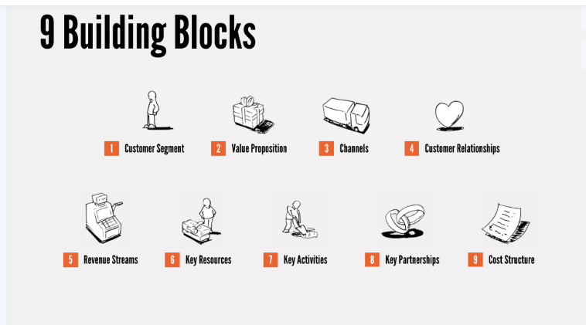
BUSINESS MODEL CANVAS

Slide 21
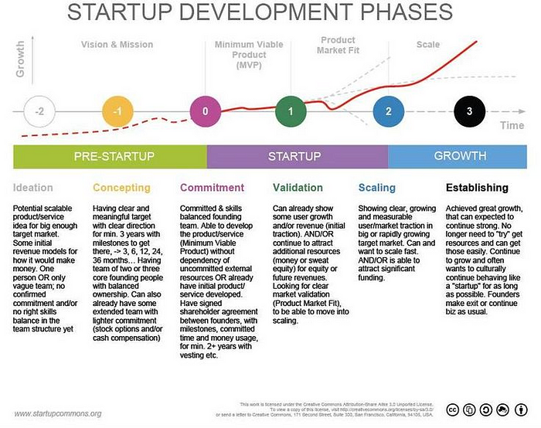

Slide 22
BREAK-EVEN ANALYSIS FOR STARTUPS
What is break-even analysis?
Determines the point where
revenue = expenses
Why is it important?
Helps in pricing strategy
Assists in securing funding
Identifies cost-cutting opportunities

Slide 23
ASSESSING SCALING UP POSSIBILITIES
Growth Strategies for Startups:
Market Expansion – Entering new geographical locations
Product Diversification – Introducing new products/services
Strategic Partnerships – Collaborating with key industry players
Automation and Process Optimization – Improving efficiency
Franchising and Licensing – Leveraging business models for expansion

